Slide 1

Amazon DynamoDB
Bhakta, Tejash
Jain, Harsh Manoj

Slide 2
Amazon DynamoDB
Fully managed NoSQL database offered by AWS
Provides consistent performance at scale
Benefits:
Flexible schema. Each row can have any number of columns
Replicates data across your choice of AWS regions. Facilitates single-digit millisecond read and write performance
No servers to provision or manage. No software to install, maintain, or operate
Notes:
Point-in-time recovery (Interesting feature): https://docs.aws.amazon.com/amazondynamodb/latest/developerguide/Backups.html
DEX for caching. Improve speeds: 4:45
Not only SQL
Hybrid DynamoDB–RDBMS
Read/Write Capacity Mode: https://docs.aws.amazon.com/amazondynamodb/latest/developerguide/HowItWorks.ReadWriteCapacityMode.html

Slide 3
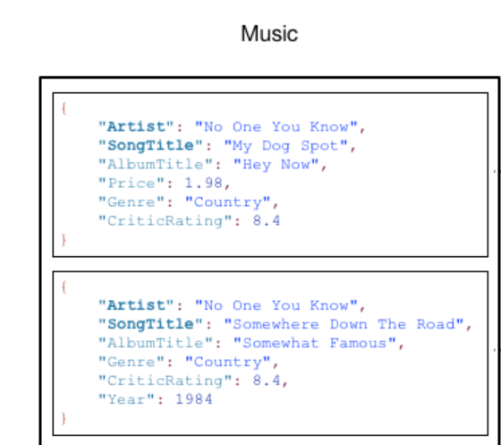
Data Model
Table
Collection of items
Items
No explicit limitations but cannot exceed 400 KB
Attributes
Composed of attribute name and value Eg. “SongTitle” : “Somewhere Down The Road”
Table
Item
Attribute
Item
Example of Music Table^{[1]}
Notes:
each table can have an infinite number of data items
Amazon DynamoDB is schema-less, in that the data items in a table need not have the same attributes or the same number of attributes.

Slide 4
Datatypes of an Attribute
Scalar
Number, String, Binary, Boolean and Null
Multi-Valued
String Set "SS": ["Pop", "Jazz" ,"Rock"]
Number Set "NS": ["42.2", "-19", "7.5", "3.14"]
Binary Set "BS": ["U3Vubnk=", "UmFpbnk=", "U25vd3k="]
Document
List "L": [ {"S": "Cookies"} , {"S": "Coffee"}, {"N", "3.14159"}]
Map "M": {"Name": {"S": "Joe"}, "Age": {"N": "35"}}

Slide 5
RDBMS vs DynamoDB
Characteristics | RDBMS | DynamoDB
Optimal Workload | Ad hoc queries, data warehousing and OLAP | Web-scale applications, including social networks, gaming, and IoT
Performance | Developers and DBA optimize queries, indexes and table structure for peak performance | Implementation details are insulated from the developer and application
Connecting to the database | Application program maintains a network connection | DynamoDB is a web-service and interactions with it are stateless
Authentication | Application cannot connect to the database until it is authenticated | Every request should contain a cryptographic signature that authenticates that request
Notes:
Video- 1:40 mins
https://docs.aws.amazon.com/amazondynamodb/latest/developerguide/SQLtoNoSQL.WhyDynamoDB.html
Deleted:
Data Access -> SQL is used to retrieve and store data -> AWS CLI or Management console. Applications can use AWS SDK.

Slide 6
Creating a table (SQL vs DynamoDB)
SQL
CREATE TABLE Music (
Artist VARCHAR(20) NOT NULL,
SongTitle VARCHAR(30) NOT NULL,
AlbumTitle VARCHAR(25),
Year INT,
Price FLOAT,
Genre VARCHAR(10),
Tags TEXT,
PRIMARY KEY(Artist, SongTitle)
);
DynamoDB
{
TableName : "Music",
KeySchema: [
{
AttributeName: "Artist",
KeyType: "HASH", //Partition key
},
{
AttributeName: "SongTitle",
KeyType: "RANGE" //Sort key
}
],
AttributeDefinitions: [
{
AttributeName: "Artist",
AttributeType: "S"
},
{
AttributeName: "SongTitle",
AttributeType: "S"
}
],
}
Creating a table in SQL^{[1]}
Creating a table in DynamoDB^{[1]}
Notes:
https://docs.aws.amazon.com/amazondynamodb/latest/developerguide/SQLtoNoSQL.CreateTable.html
Some of the items have a nested attribute (Address). DynamoDB supports nested attributes up to 32 levels deep.

Slide 7
Primary Key
DynamoDB
{
TableName : "Music",
KeySchema: [
{
AttributeName: "Artist",
KeyType: "HASH", //Partition key
},
{
AttributeName: "SongTitle",
KeyType: "RANGE" //Sort key
}
],
AttributeDefinitions: [
{
AttributeName: "Artist",
AttributeType: "S"
},
{
AttributeName: "SongTitle",
AttributeType: "S"
}
],
}
When you create a table, you must mention the primary key. Other than the primary key, the table is schemaless.
Two types:
Partition Key
Composed of one attribute
The key’s value is used as an input to an internal hash function
The output from the hash function determines the partition for storage
Partition and Sort Key
Partition key as input and storage partition as output from the hash function
All items with the same partition key value are stored together, in sorted order by sort key value
Partition Key: “Artist” Sort Key: “SongTitle”
Example of Music Table^{[1]}
Notes:
A composite primary key gives you additional flexibility when querying data. For example, if you provide only the value for Artist, DynamoDB retrieves all of the songs by that artist. To retrieve only a subset of songs by a particular artist, you can provide a value for Artist along with a range of values for SongTitle.
https://docs.aws.amazon.com/amazondynamodb/latest/developerguide/HowItWorks.CoreComponents.html#HowItWorks.CoreComponents.PrimaryKey

Slide 8
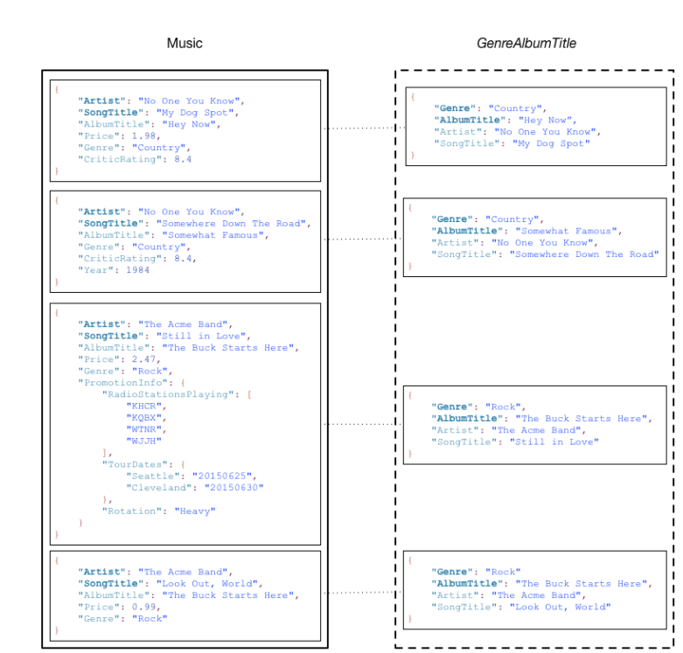
Query, Scan and Filters
Query - Select multiple items that have the same “HASH’ key but different “RANGE” key.
Give me all SongTitle from “The Acme Band”
Scan - Reads every item in a table or a Secondary Index.
Filter - Refines the Scan/Query results
aws dynamodb scan \
--table-name Music \
--projection-expression "SongTitle" \
--filter-expression “Genre = :gen” \
--expression-attribute-values '{":gen":{S: “Rock”"}}' \
Example of Music Table^{[1]}
Example of Music Table^{[1]}
Notes:
Amazon DynamoDB provides the following operations for reading data:
Querying is a very powerful operation in DynamoDB. It allows you to select multiple Items that have the same partition ("HASH") key but different sort ("RANGE") keys.
The Query call is like a shovel -- grabbing a larger amount of Items but still small enough to avoid grabbing everything.
The Scan operation is like a payloader, grabbing everything in its path: The Scan operation generally makes sense only in the following situations:
you have a very small table;
you're exporting all of your table's data to another storage system; or

Slide 9
Secondary Indexes
Specify alternate key structures which can be used in Query or Scan operations
Fast way of accessing a non-key attribute
Two types of secondary indexes
Local Secondary Index
Global Secondary Index
Quota of 20 Global Secondary Indexes and 5 local secondary indexes
Notes:
Data structure that contains a subset of attributes
A table can have multiple secondary indexes, which give your applications access to many different query patterns.

Slide 10
Properties of Secondary Indexes
Every index belongs to a table (base table).
DynamoDB maintains the indexes automatically.
When creating an index, the user specifies which attributes to be copied or projected from the base table.
KEYS_ONLY
INCLUDE
ALL
Example of Global Secondary Index^{[1]}
Notes:
In the example Music table shown previously, you can query data items by Artist (partition key) or by Artist and SongTitle (partition key and sort key). What if you also wanted to query the data by Genre and AlbumTitle? To do this, you could create an index on Genre and AlbumTitle, and then query the index in much the same way as you'd query the Music table.
The following diagram shows the example Music table, with a new index called GenreAlbumTitle. In the index, Genre is the partition key and AlbumTitle is the sort key.
When you add, update, or delete an item in the base table, DynamoDB adds, updates, or deletes the corresponding item in any indexes that belong to that table.
When you create an index, you specify which attributes will be copied, or projected, from the base table to the index. At a minimum, DynamoDB projects the key attributes from the base table into the index. This is the case with GenreAlbumTitle, where only the key attributes from the Music table are projected into the index.
You can query the GenreAlbumTitle index to find all albums of a particular genre (for example, all Rock albums). You can also query the index to find all albums within a particular genre that have certain album titles (for example, all Country albums with titles that start with the letter H).
Global and local indexes are allowed to have duplicate hash key & range key pairs. Only the hash key and range key of the table itself are unique

Slide 11
Global Secondary Index
Primary Key can either be simple or composite
Partition Key and Sort Key (if any) can be any base table attributes.
Can add this index either at creation or at a later stage
Example Query:
All Albums from “Rock” Genre.
All songs from “Rock” Genre and “The Buck Starts Here”
Example of Global Secondary Index^{[1]}
Notes:
GSI is another table with the subset of the attributes from the main table.

Slide 12
Local Secondary Index
Same HASH key(Partition key) as the base table but different RANGE(Sort) key.
Can be specified only at Table creation.
Example Query
Get the year and genre for a particular album.
Create Table
aws dynamodb create-table \
--table-name Music \
--attribute-definitions \
AttributeName=Artist,AttributeType=S \ AttributeName=SongTitle,AttributeType=S \
AttributeName=AlbumTitle,AttributeType=S \
--key-schema
AttributeName=Artist,KeyType=HASH \
AttributeName=SongTitle,KeyType=RANGE \
--local-secondary-indexes \
"[{"IndexName": "AlbumTitleIndex",
"KeySchema":
[{"AttributeName":"Artist","KeyType":"HASH"},
{"AttributeName":"AlbumTitle","KeyType":"RANGE"}],
"Projection":{"ProjectionType":"INCLUDE", "NonKeyAttributes":[”Genre", "Year"]}}]"
aws dynamodb query \
--table-name Music \
--index-name AlbumTitleIndex \
--key-condition-expression "Artist = :v_artist and AlbumTitle = :v_title" \
--expression-attribute-values '{":v_artist":{"S":"Acme Band"},":v_title":{"S":"Songs About Life"} }'
Query on LSI^{[1]}
Define LSI on creation of the table^{[1]}
Notes:
Some applications only need to query data using the base table's primary key. However, there might be situations where an alternative sort key would be helpful.
Therefore, it can be added on tables with composite primary keys.

Slide 13
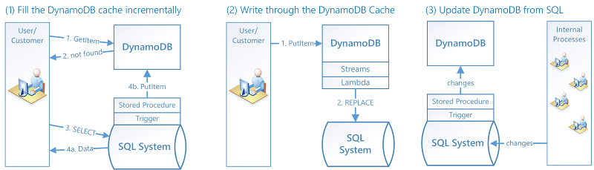
Hybrid DynamoDB–RDBMS
Sometimes organizations might not find it beneficial to migrate from RDBMS to DynamoDB
You can setup a hybrid system where DynamoDB creates a materialized view of the data stored in the RDBMS and handles high-traffic requests against this view
When an item is queried, look for it in DynamoDB
If it is not there, look for it in the SQL System and load it into DynamoDB
Notes:
For example, some organizations maintain legacy systems and it might to too risky and expensive to migrate data from these systems.
Learn Streams and Lambda
https://docs.aws.amazon.com/amazondynamodb/latest/developerguide/bp-hybrid.html

Slide 14
When a customer changes a value in the DynamoDB, a lambda function is triggered to write the data to the SQL system
When a value is changed in the SQL system, a stored procedure is triggered to update the value in the DynamoDB materialized view
Hybrid DynamoDB-RDBMS^{[1]}

Slide 15
PartiQL
PartiQL is a SQL-Compatible query language for DynamoDB
You can select, insert, update and delete data. You can interact with DynamoDB tables and run ad hoc queries
Create an item in the Music table
aws dynamodb execute-statement --statement "INSERT INTO Music VALUE {'Artist':'Acme Band','SongTitle':'PartiQL Rocks'}"
Retrieve an item from the Music table
aws dynamodb execute-statement --statement "SELECT * FROM Music WHERE Artist='Acme Band' AND SongTitle='PartiQL Rocks'"
Notes:
GetItem
PutItem actions used for their APIs

Slide 16
Performing Transactions with PartiQL
You cannot mix both read and write statements in one transaction. You can either have only read or only write operations
Save the following json
[
{
"Statement": "EXISTS(SELECT * FROM Music where Artist='No One You Know' and SongTitle='Call Me Today' and Awards is MISSING)"
},
{
"Statement": "INSERT INTO Music value {'Artist':'?','SongTitle':'?'}",
"Parameters": [{"S": "Acme Band"}, {"S": "Best Song"}]
},
{
"Statement": "UPDATE Music SET AwardsWon=1 SET AwardDetail={'Grammys':[2020, 2018]} where Artist='Acme Band' and SongTitle='PartiQL Rocks'"
}
]
Execute the transaction
aws dynamodb execute-transaction --transact-statements file://partiql.json
Performing transactions with PartiQL^{[1]}
Notes:
https://docs.aws.amazon.com/amazondynamodb/latest/developerguide/ql-reference.multiplestatements.transactions.html#ql-reference.multiplestatements.transactions.parameters
https://docs.aws.amazon.com/amazondynamodb/latest/developerguide/SQLtoNoSQL.ReadData.Query.html#SQLtoNoSQL.ReadData.Query.DynamoDB
https://docs.aws.amazon.com/amazondynamodb/latest/developerguide/transactions.html
With the transaction write API, you can group multiple Put, Update, Delete, and ConditionCheck actions. You can then submit the actions as a single TransactWriteItems operation that either succeeds or fails as a unit. The same is true for multiple Get actions, which you can group and submit as a single TransactGetItems operation.
Exists is an exception

Slide 17
References
[1] https://docs.aws.amazon.com/amazondynamodb/latest/developerguide/Introduction.html
Core Components
Creating a table
Working with Indexes
Hybrid DynamoDB-RDBMS
Performing transactions with PartiQL
[2] https://www.dynamodbguide.com/

